Slide 1
Web and Cloud development:
index.py
workshop.py
using Python’s Flask
and AWS
Session 2
By Mahmoud Reda
STP’22|Engineering

Slide 2
index.py
workshop.py
< “Live as if you were to die tomorrow. Learn as if you were to live forever.>
STP’22|Engineering

Slide 3
index.py
workshop.py
Session 1???
STP’22|Engineering

Slide 4
Content:
index.py
workshop.py
framework
Examples on API
What is framework?
Why we use it?
Flask
API
POST and GET
History
Why flask?
Flask syntax and small app
Frontend
JINJA
STP’22|Engineering

Slide 5

Framework:
index.py
workshop.py
What is the framework?
Why we use it ?
STP’22|Engineering

Slide 6

index.py
workshop.py
GUESS WHAT ARE THE THINGS IN THE FRAMEWORK??
STP’22|Engineering

Slide 7
Flask:
index.py
workshop.py
History of Flask
Why use Flask
Flask syntax
STP’22|Engineering

Slide 8
Workshop.py
tableOfContent.json
#import class Flask form flask
from flask import Flask
#create the object from the class and it is the app
app = Flask(__name__)
#create a route and page to this route
@app.route(“/”)
def Home():
#this return value is rendered like html page
return “welcome to Home Page”
’’’the function to run my app to make it starts and it works in only in this file and not in another extended files’’’
if __name__==“__main__”
app.run()
STP’22|Engineering

Slide 9
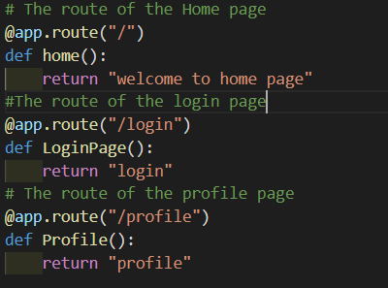
Routing:
index.py
workshop.py
STP’22|Engineering

Slide 10
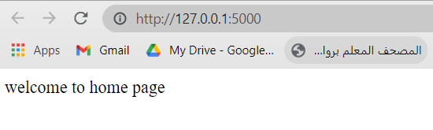
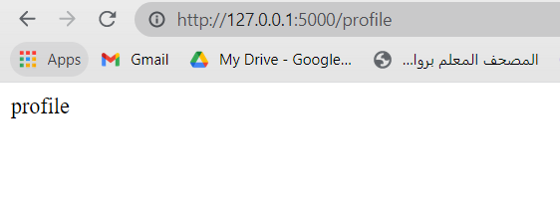
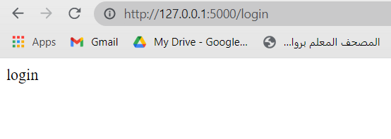
Routes:
index.py
workshop.py
STP’22|Engineering

Slide 11
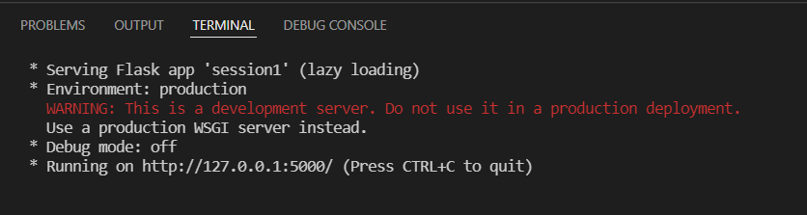
Run Function :
Port =5000 debug=false
index.py
workshop.py
STP’22|Engineering

Slide 12
Directing functions :
index.py
workshop.py
redirect() && url_for()
STP’22|Engineering

Slide 13

Frontend :
index.py
workshop.py
1-how can I render the template
coding
STP’22|Engineering

Slide 14
coding
index.py
workshop.py
2-what is JINJA??why we use it??
STP’22|Engineering

Slide 15
index.py
workshop.py
{{user}} VS user
In for loop??
STP’22|Engineering

Slide 16
index.py
workshop.py
Examples on APIS
STP’22|Engineering

Slide 17

index.py
workshop.py
STP’22|Engineering

Slide 18
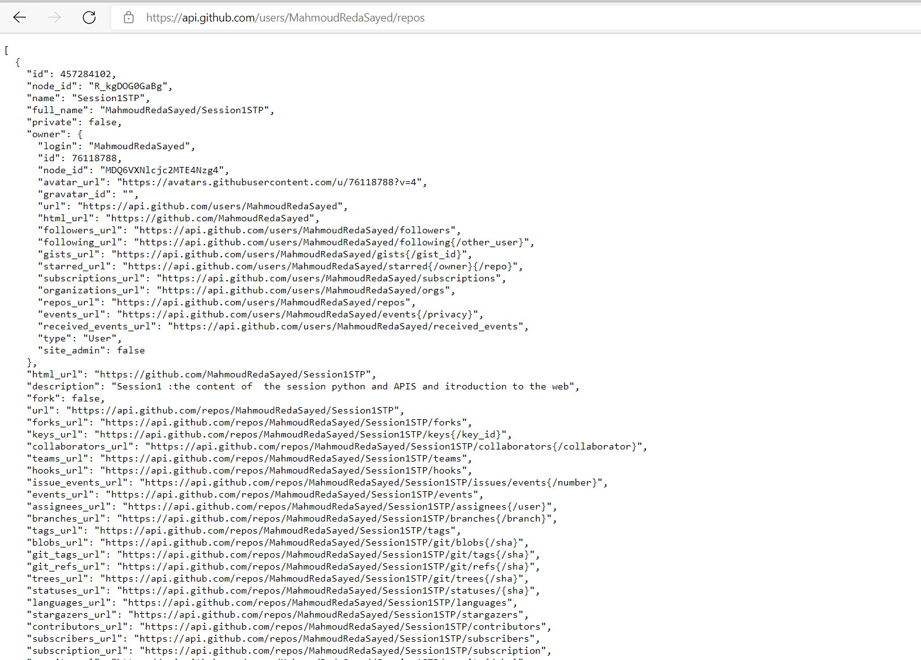
index.py
workshop.py
{{user}} VS user
In for loop??
STP’22|Engineering

Slide 19
Simple API:
index.py
workshop.py
-GET and POST
STP’22|Engineering

Slide 20
THANK TANK
index.html
web.js
STP’22|Engineering

Slide 21
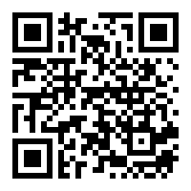
Your Opinion Matters
index.html
web.js
STP’22|Engineering

